Slide 1
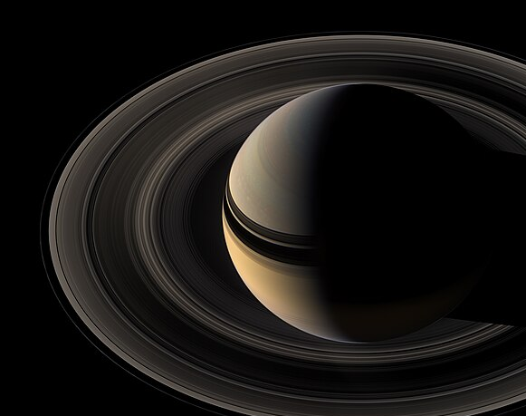
Towards reflected light exoplanet detection with extreme AO and ELTs
Logan Pearce
ELT Fellow, U-M Astronomy
Colloquium 19 Sep 2024

Slide 2
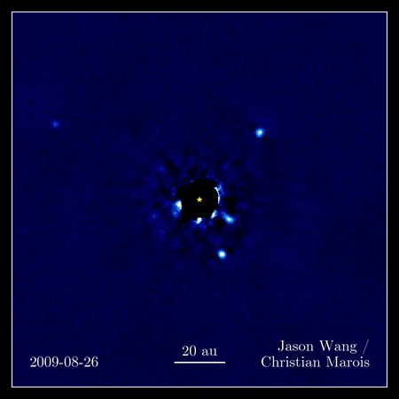
Direct Imaging is the future of exoplanet science
Observable
Astrometry
Orbit
Mass
Photometry
Populations
Spectroscopy
Formation/Evolution
Molecular absorption/emission
Biosignatures
Atmosphere Composition

Slide 3
Regions where DI is sensitive currently have detected very few planets
Credit: Rachel Bowins-Rubin and Logan Pearce
Available on my website www.loganpearce.com

Slide 4
DI is very hard!
Stars are bright
Planets are faint and close to stars
Follette et al. 2023

Slide 5
Need to push detection to fainter and closer planets

Slide 6
Need to push detection to fainter and closer planets
Direct detection of Earth-like planets and biosignatures from ground-based extremely large telescopes is one of the top priorities of the astronomy field in the 2020s

Slide 7
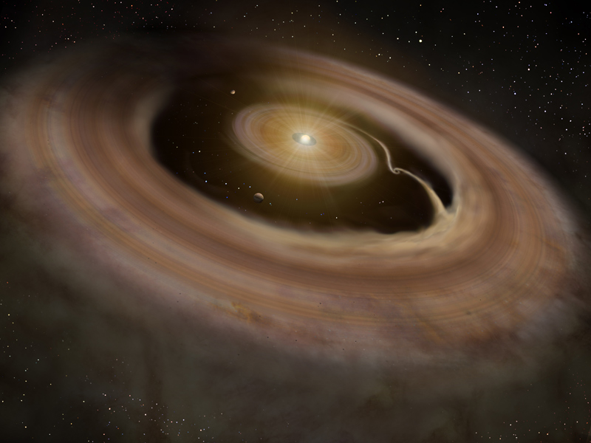
How we directly detect planets: Thermal Emission
Gas and dust
Heats up
Growing planet
Young planets are hot and glow in IR wavelengths
Artist impression/NAOJ

Slide 8
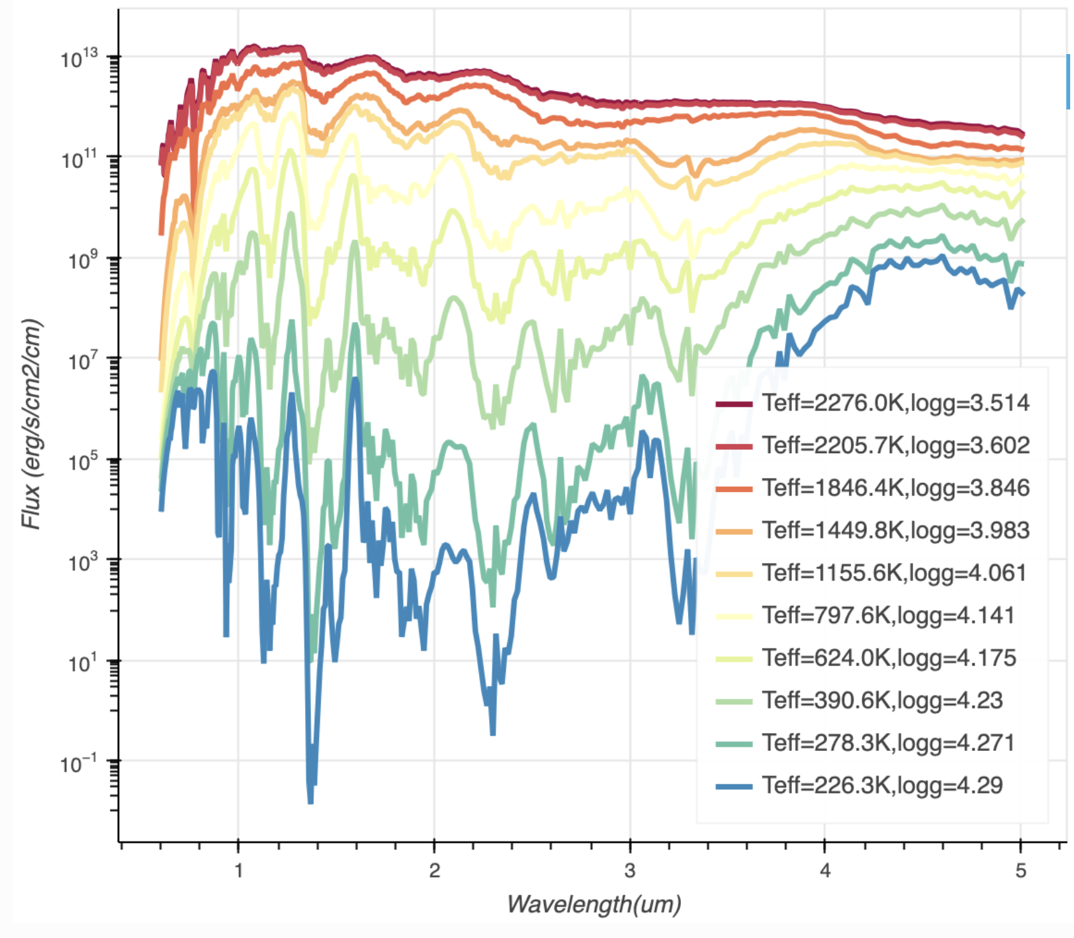
How we directly detect planets: Thermal Emission
Gas and dust
Heats up
Growing planet
Young planets are hot and glow in IR wavelengths
Artist impression/NAOJ
Credit: PICASO documentation

Slide 9
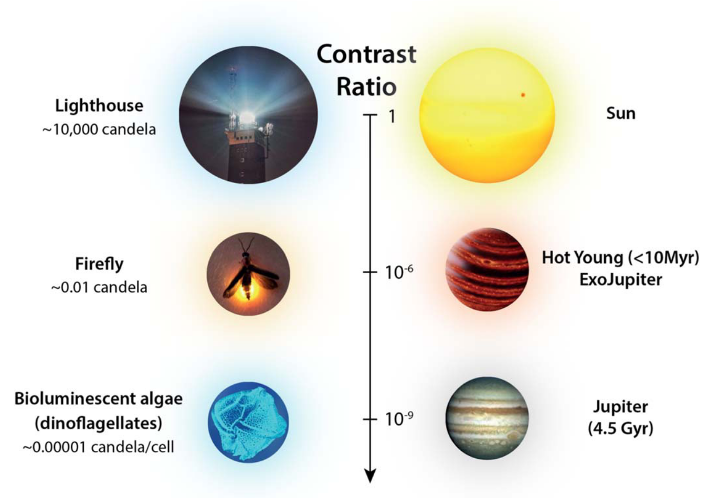
How we directly detect planets: Reflected Light

Slide 10
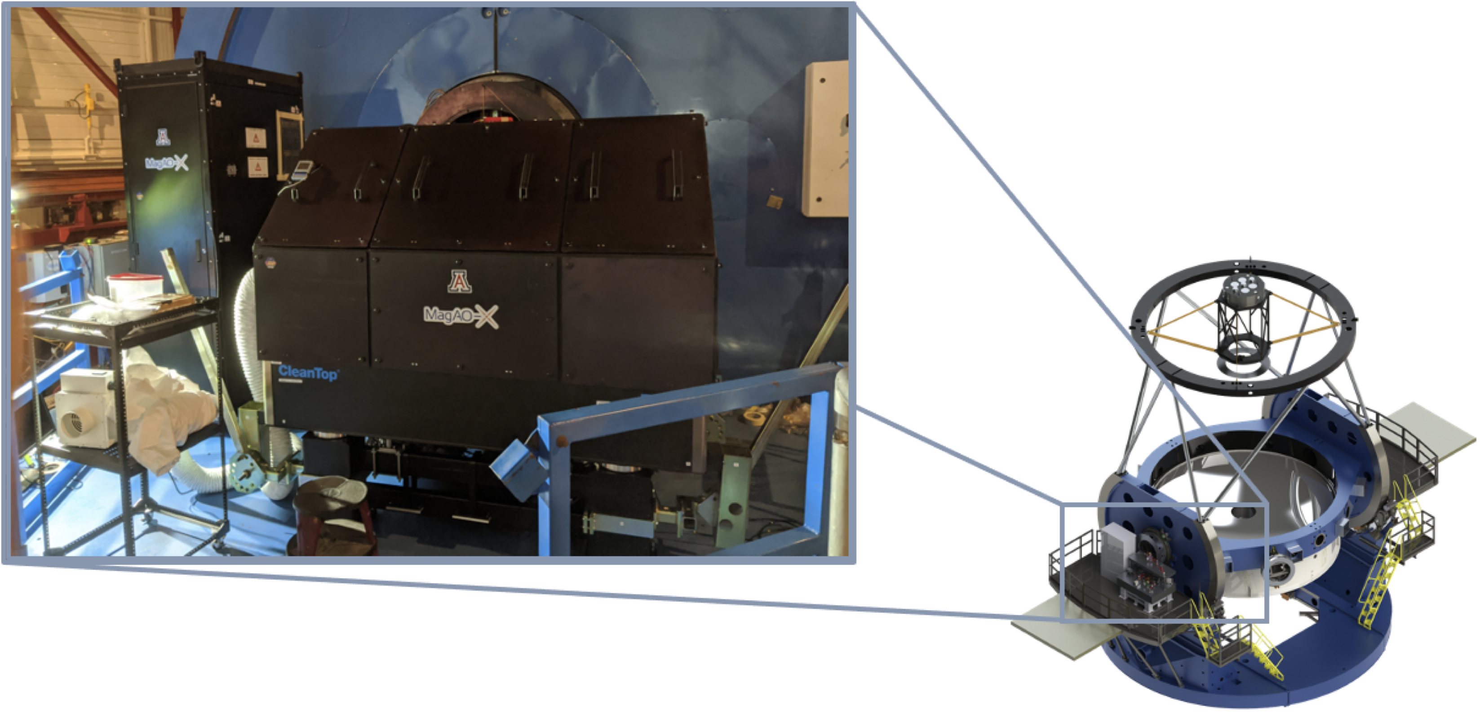
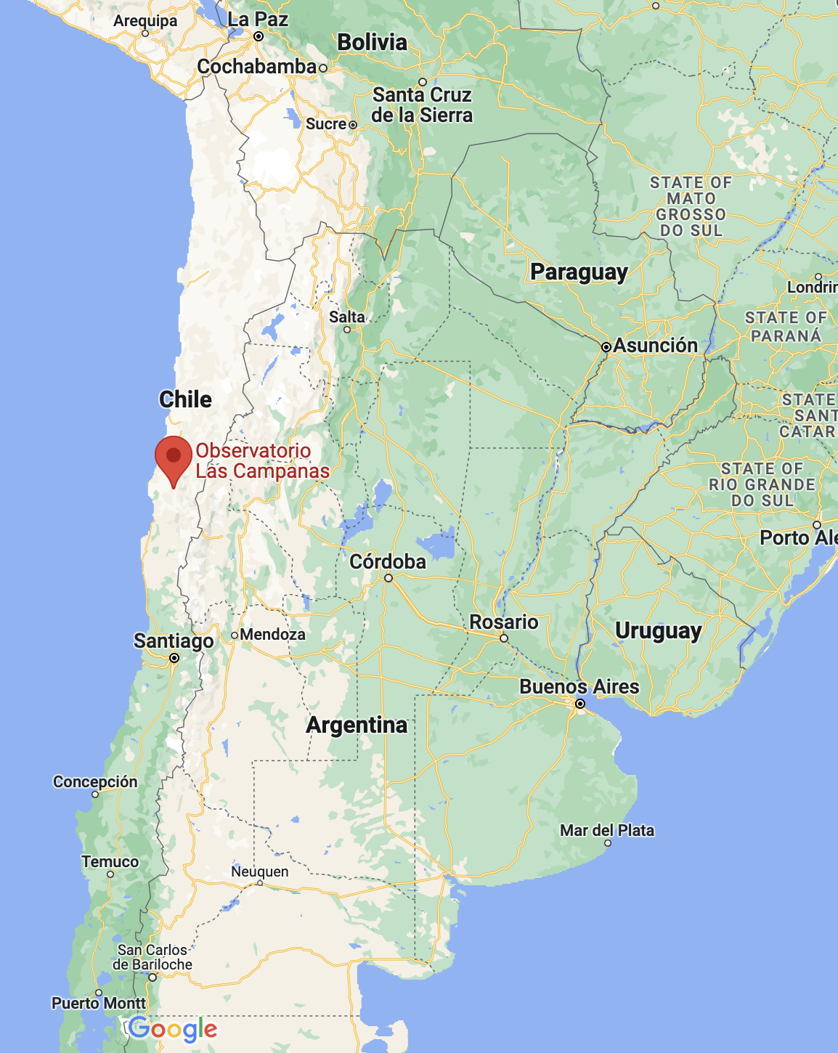
Detecting nearby planets in reflected light is the ultimate science goal of MagAO-X

Slide 11
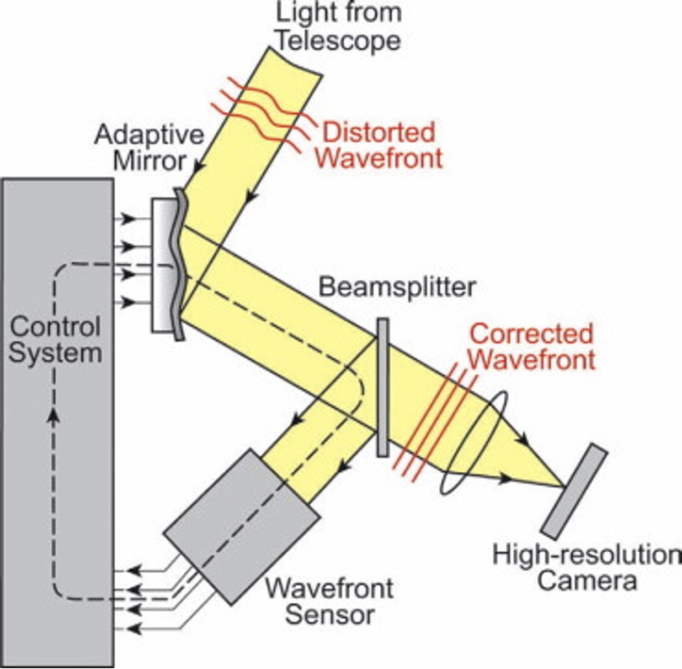
Adaptive Optics is how we achieve diffraction limited imaging from the ground

Slide 12
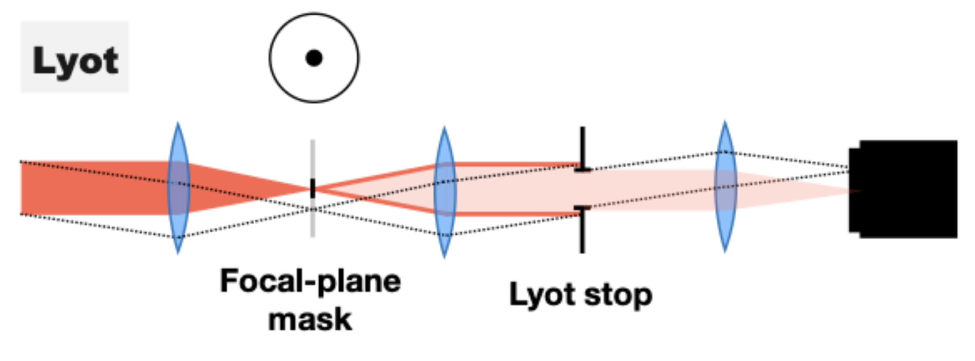
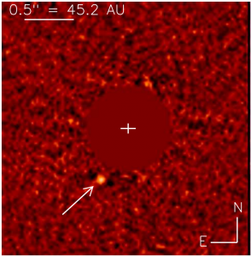
High contrast imaging is achieved through AO + Coronagraphy + post-processing
Coronagraphy
Adaptive Optics
Block on-axis light (star) while allowing off-axis light to pass through -> “dark hole” region of high contrast
Post-Processing
Remove starlight and speckles to reveal faint objects
Diffraction-limited imaging from the ground

Slide 13
High contrast imaging is achieved through AO + Coronagraphy + post-processing
Coronagraphy
Adaptive Optics
Block on-axis light (star) while allowing off-axis light to pass through -> “dark hole” region of high contrast
Currie et al. 2023
Post-Processing
Remove starlight and speckles to reveal faint objects
Diffraction-limited imaging from the ground

Slide 14
High contrast imaging is achieved through AO + Coronagraphy + post-processing
Coronagraphy
Adaptive Optics
Block on-axis light (star) while allowing off-axis light to pass through -> “dark hole” region of high contrast
Currie et al. 2023
Post-Processing
Remove starlight and speckles to reveal faint objects
Diffraction-limited imaging from the ground

Slide 15
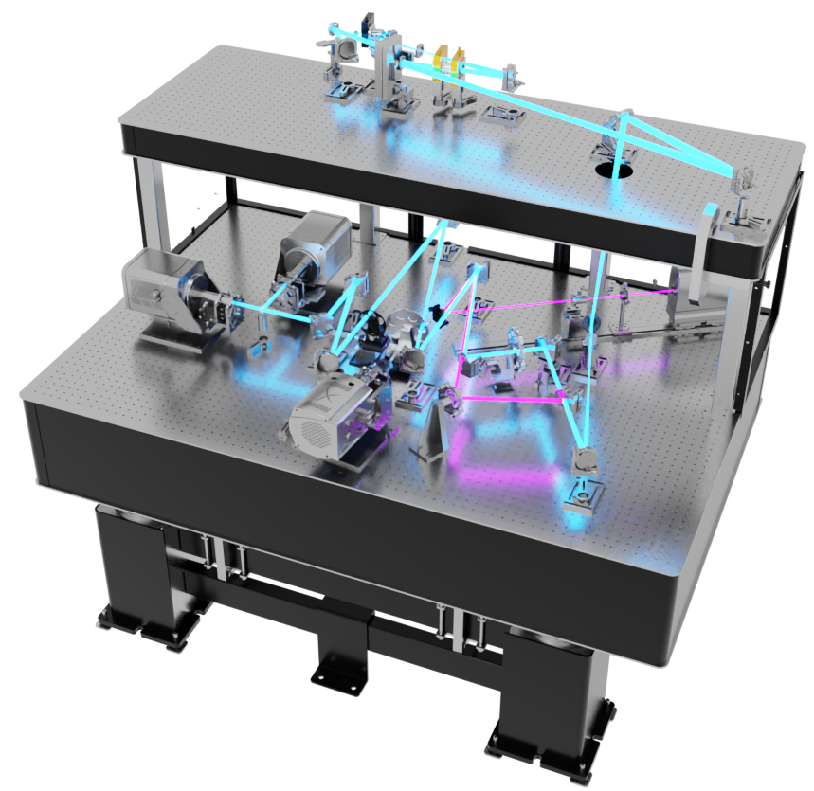
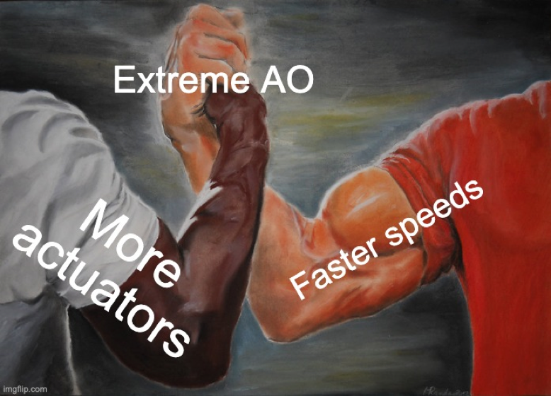
97 actuator “woofer” DM
2K actuator “tweeter” DM
Science Cameras
g’, r’, i’, z’, Ha, CH4
Pyramid WFS
VIS-X IFU
Beam Splitter
Coronagraph and 1K NCPC DM
Credit: Joseph Long
More at xwcl.science

Slide 16
AO Off -> AO On: Pi Pup
Watch for the planet
Credit: Joseph Long

Slide 17
Pi Pup: As we control more modes, the speckle suppression region grows

Slide 18
Detection of the nearest known exoplanets in reflected light is the ultimate science goal of MagAO-X

Slide 19
Reflected Light Exoplanet Detection

Slide 20
Exoplanet Reflected Light Imaging with MagAO-X
GJ 876 b/c
Detecting nearby planets in reflected light is the ultimate science goal of MagAO-X
Proxima Centauri b

Slide 21
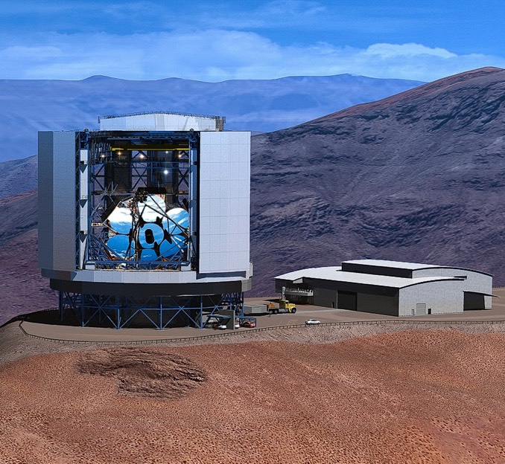
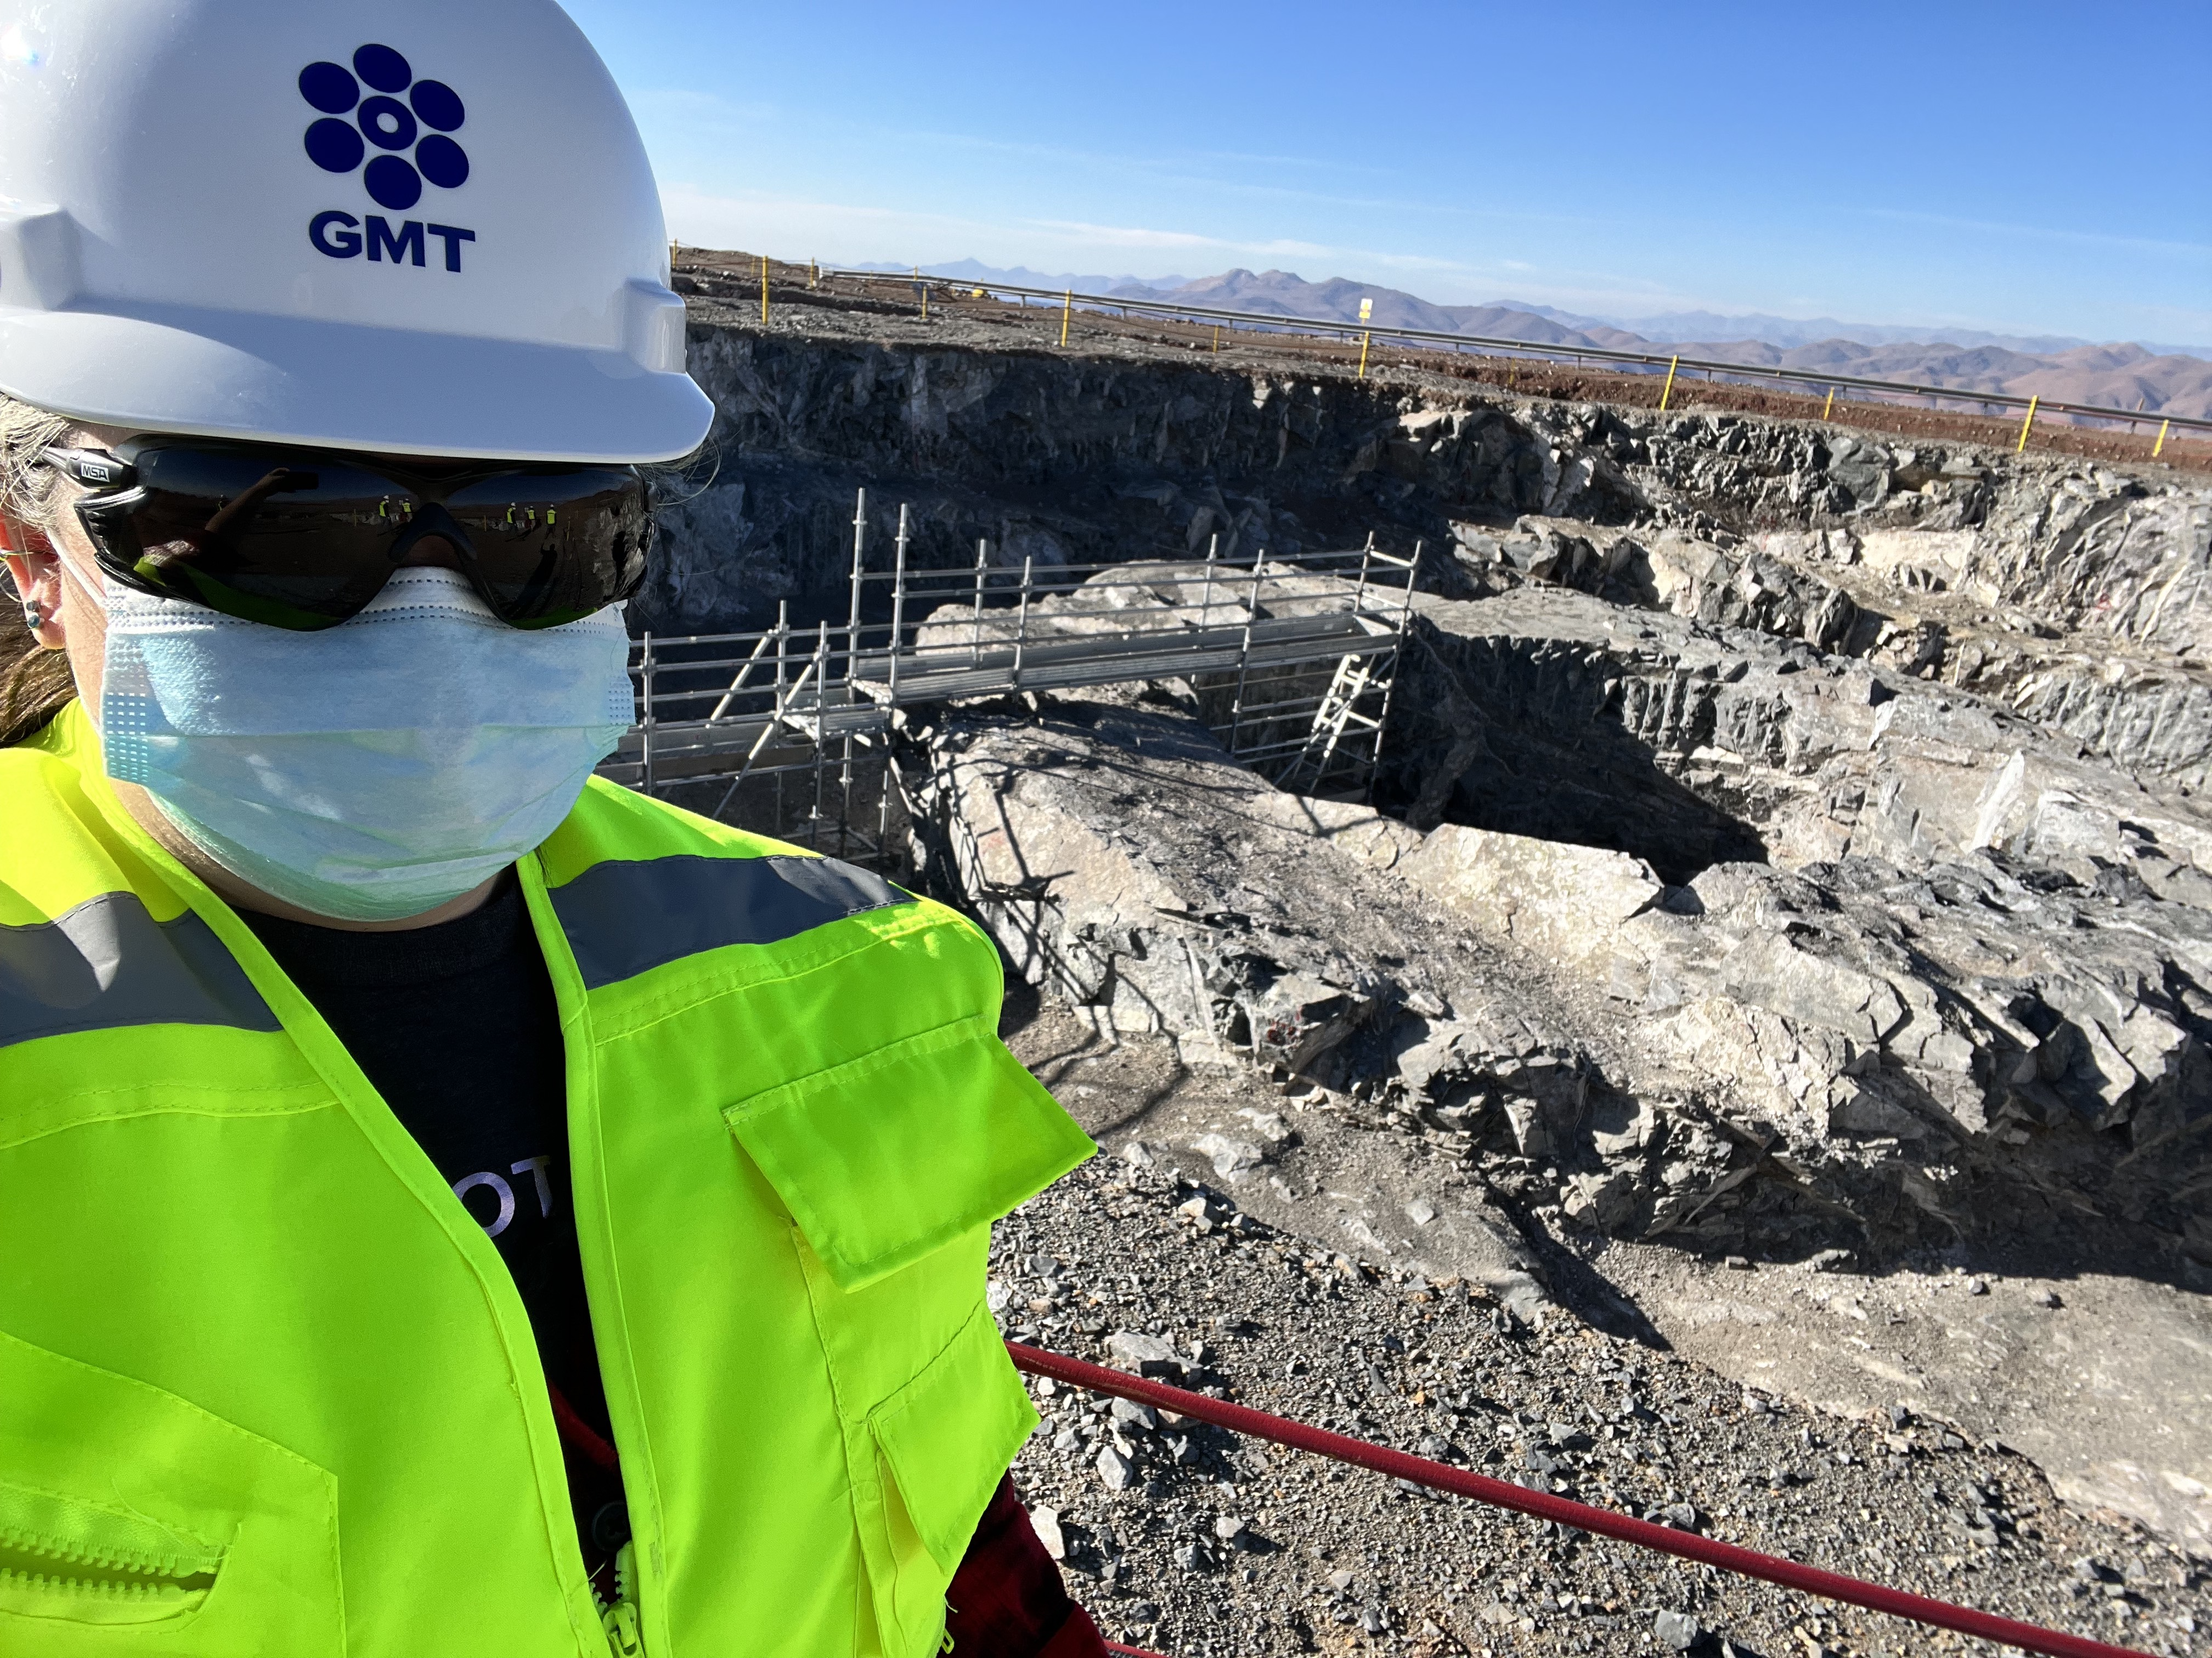
MagAO-X is a pathfinder for GMagAO-X
GMT: 25.4 m primary being built in Chile planned for 2030’s
GMagAO-X: ExAO coronagraphic instrument planned to be ready at first light being built by XWCL
Credit: giantmagellan.org
GMT site April 2022

Slide 22
ELT-PCS is the planned ExAO+Coron instrument
Credit: ESO

Slide 23
That same plot for GMagAO-X – 25.4m primary
GJ 876 b/c
Bigger light bucket -> collect more photons!
Larger mirror -> able to resolve closer things!
Proxima Centauri b

Slide 24
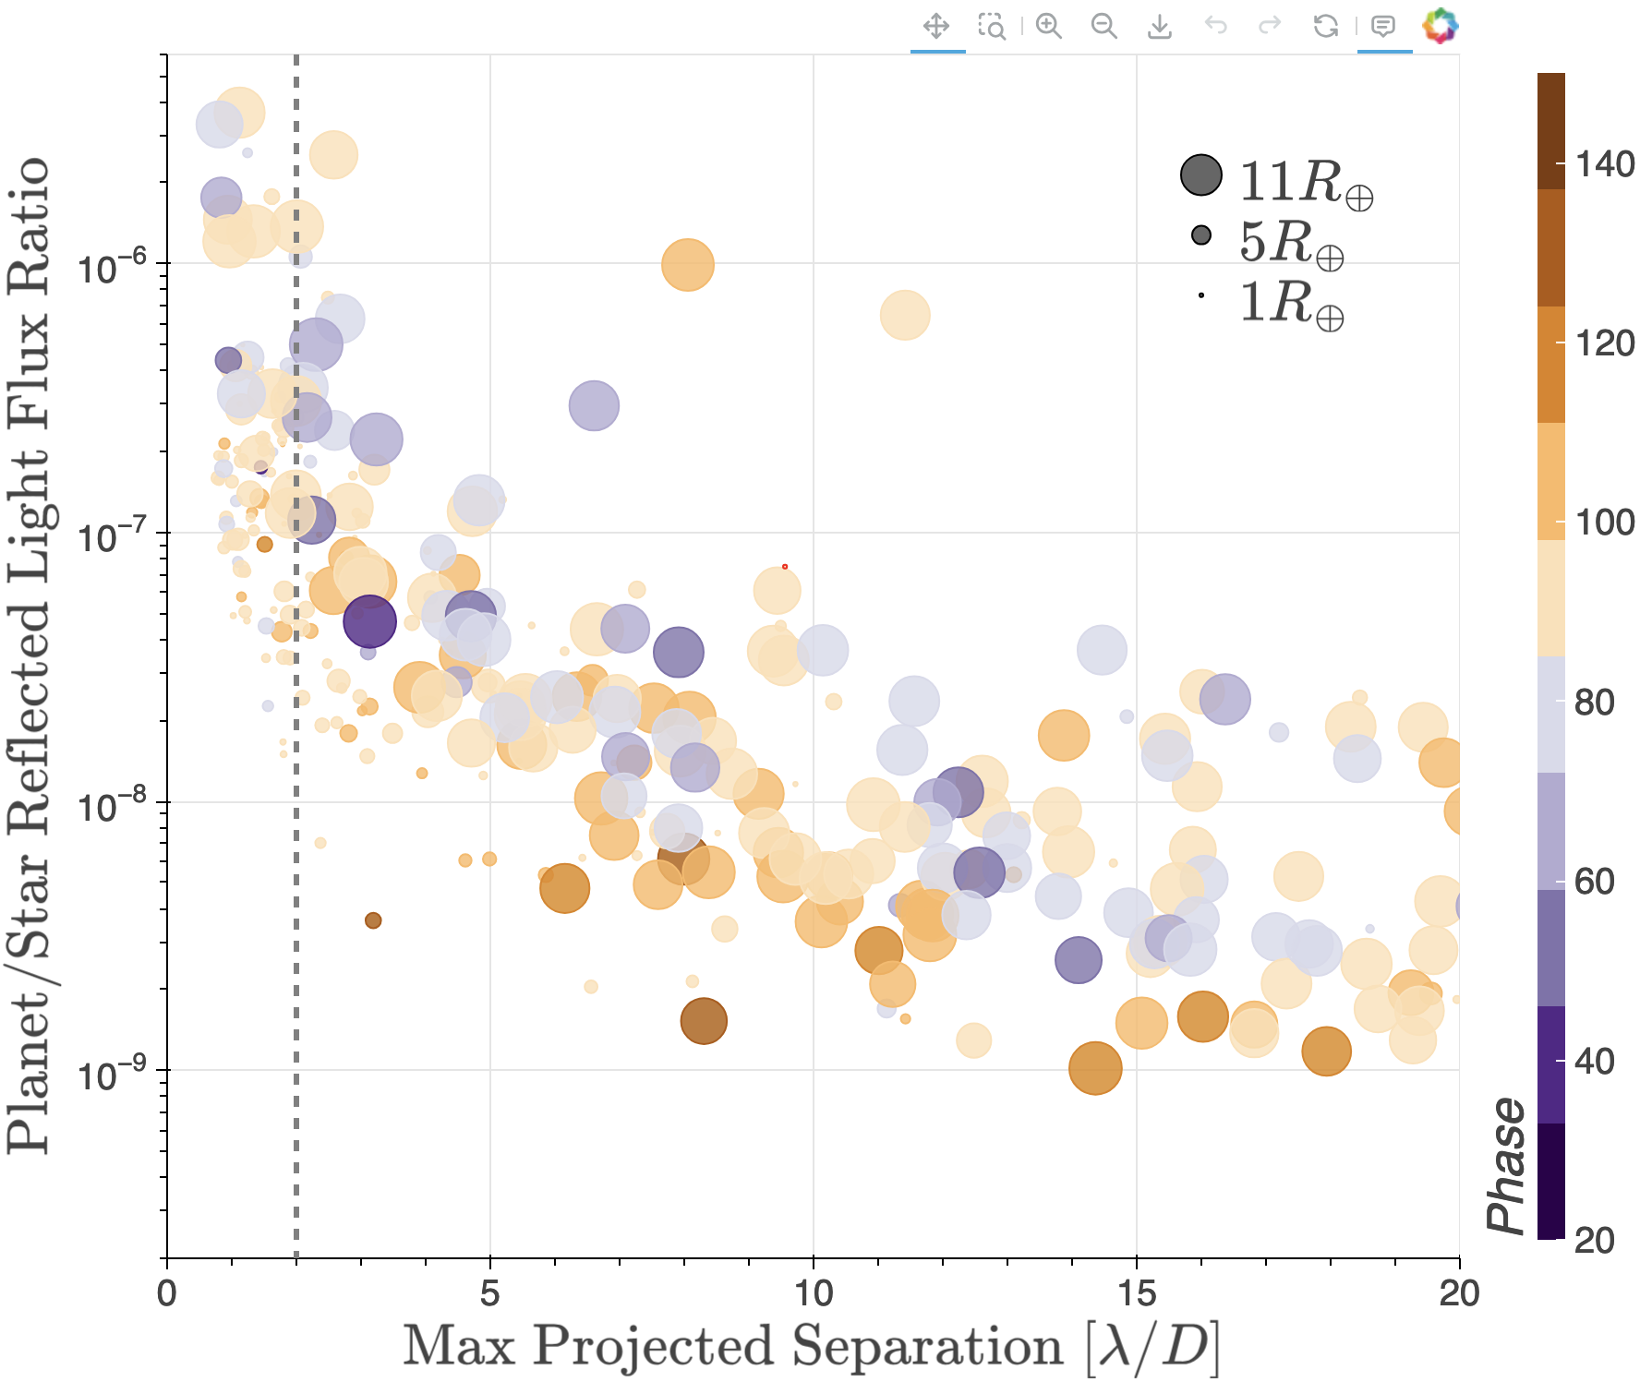
That same plot for ELT and ELT-PCS – 39m primary
GJ 876 b/c
Bigger light bucket -> collect more photons!
Larger mirror -> able to resolve closer things!
Proxima Centauri b

Slide 25
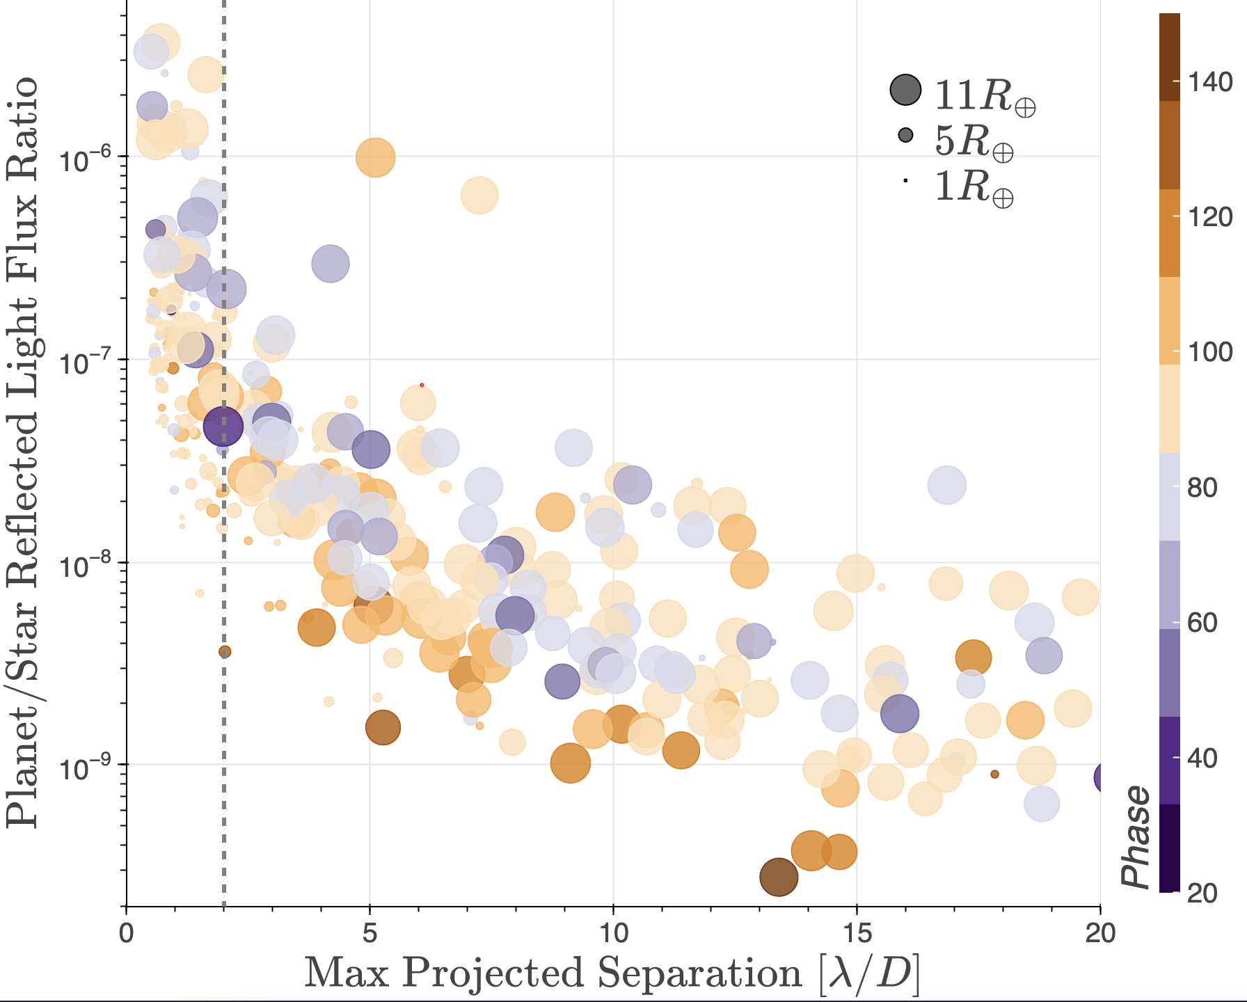
Contrast depends on atmosphere, separation, radius, and phase

Slide 26
Contrast depends on atmosphere, separation, radius, and phase
Closer to star = brighter

Slide 27
Contrast depends on atmosphere, separation, radius, and phase
Closer to star = brighter
Larger radius = brighter

Slide 28
Contrast depends on atmosphere, separation, radius, and phase
Closer to star = brighter
Larger radius = brighter
Smaller phase angle = brighter

Slide 29
Contrast depends on atmosphere, separation, radius, and phase
Closer to star = brighter
Larger radius = brighter
Smaller phase angle = brighter
And atmospheric albedo….

Slide 30
Atmospheric features as a function of wavelength

Slide 31
The ReflectX model suite is designed to prepare for ExAO reflected light observations
Star properties
Planet properties
Mass
Radius
Met.
C/O
Separation
Phase
Atm comp
Mass
Radius
Metallicity
Log(g)
Teff
Observing Characteristics
Star Magnitude
Observing conditions
Batalha et al. 2019
Instrument configuration:
Speckle noise
WFC configuration
Coronagraph char.
Noise characteristics
ReflectX spectra
Survey yields
Instrument design
Survey Design
Forward models
Males et al. 2021
Detectable planets & features

Slide 32
The ReflectX model suite is designed to prepare for ExAO reflected light observations
Star properties
Planet properties
Mass
Radius
Metallicity
Log(g)
Teff
Mass
Radius
Met.
C/O
Separation
Phase
Atm comp
Observing Characteristics
Publication of first model results expected in 2024
Star Magnitude
Observing conditions
Batalha et al. 2019
Instrument configuration:
Speckle noise
WFC configuration
Coronagraph char.
Noise characteristics
ReflectX spectra
Survey yields
Instrument design
Survey Design
Forward models
Males et al. 2021
Detectable planets & features

Slide 33
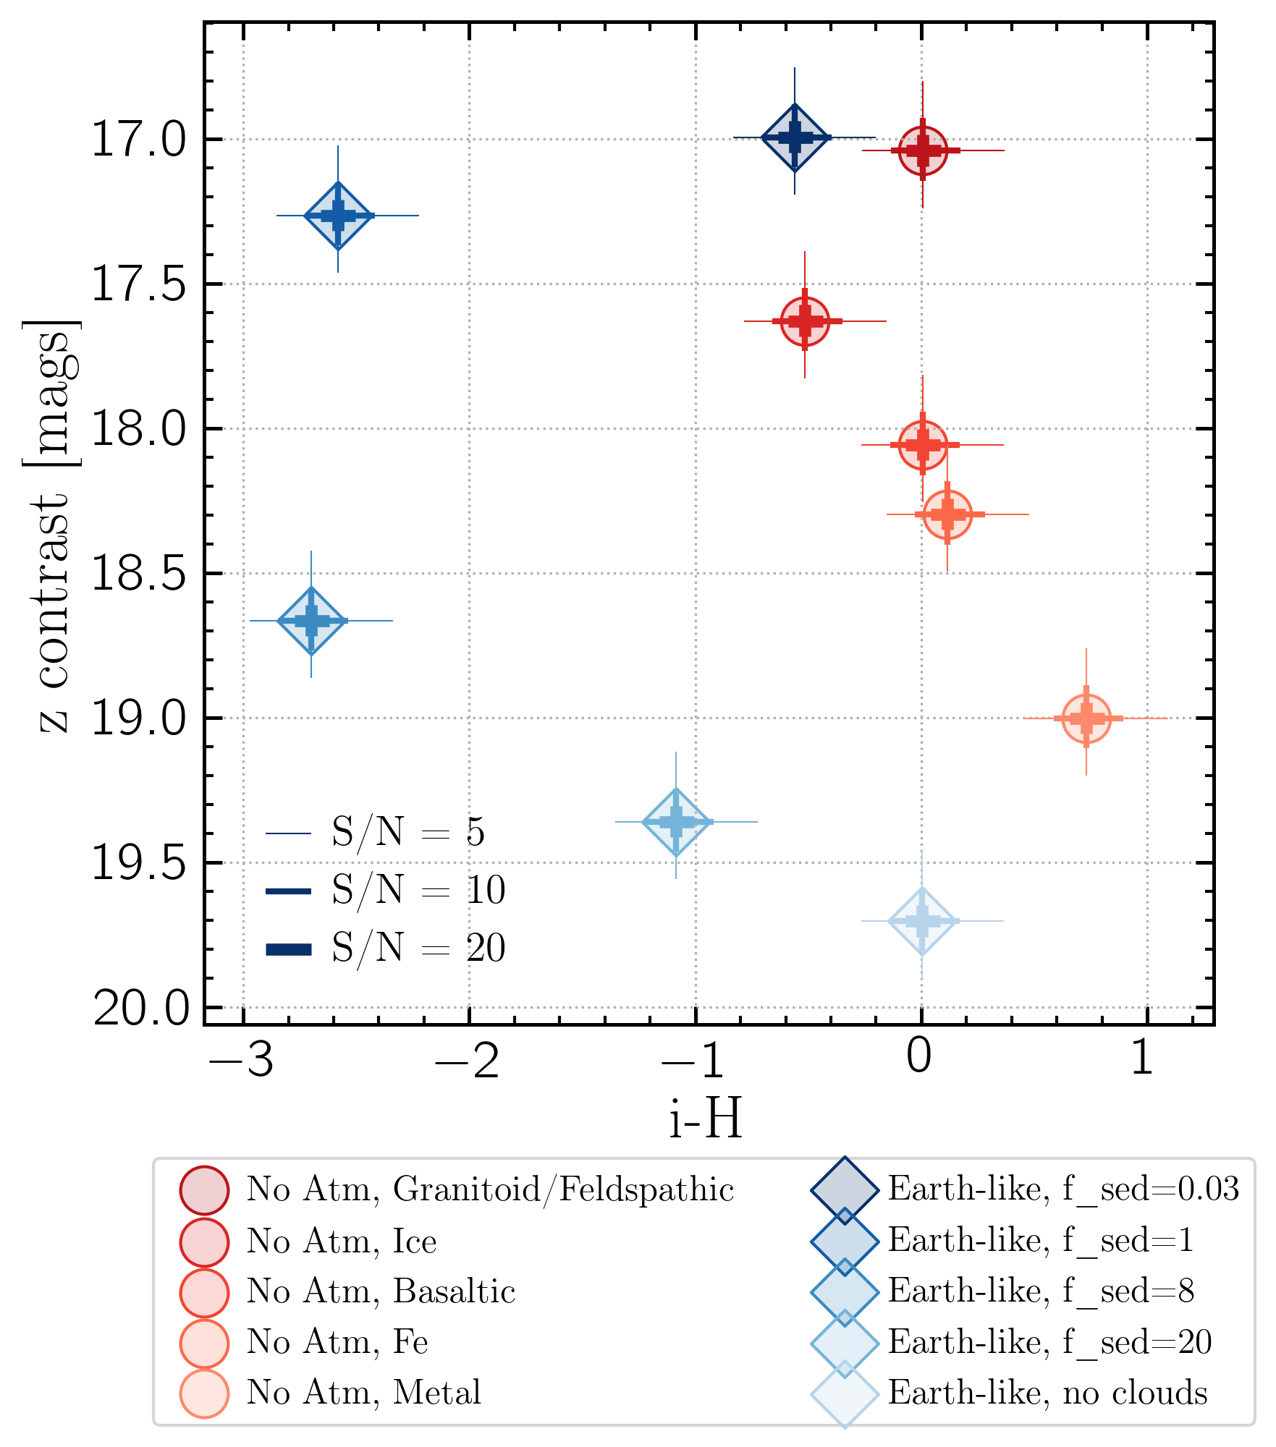
ReflectX will consist of
A generic grid of reflected light models spanning star and planet parameters
A suite of models of specific known planets
A tool for producing predictions based on the models
Prox Cen b airless and Earth-like atmosphere models in color-magnitude space

Slide 34
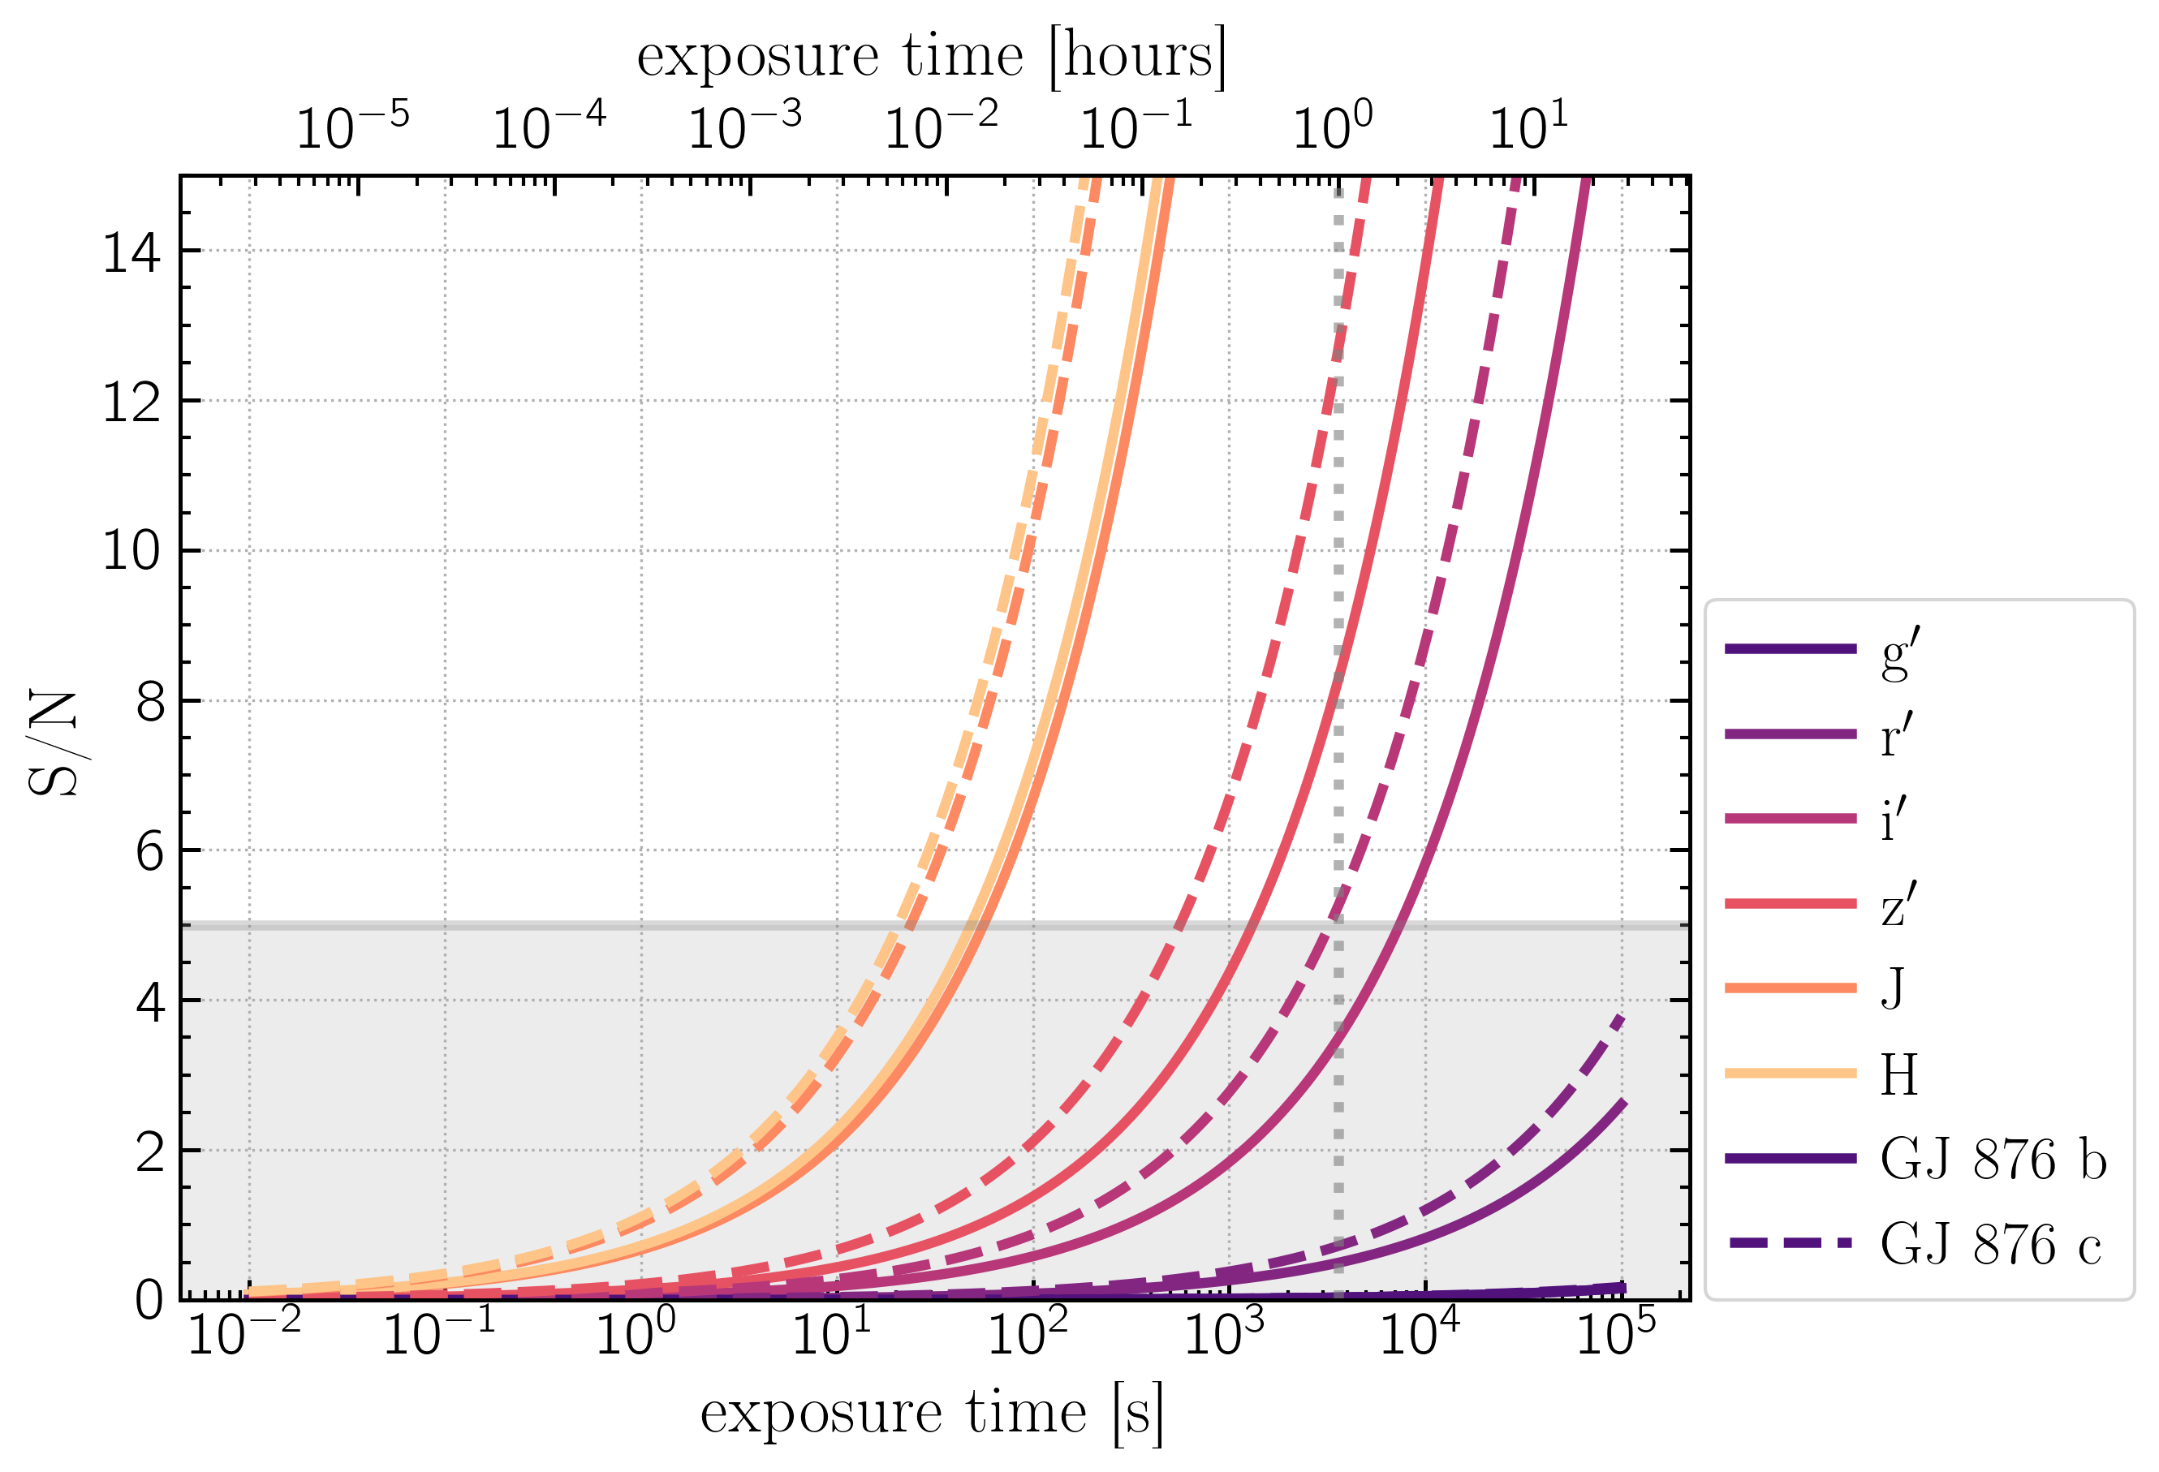

Slide 35
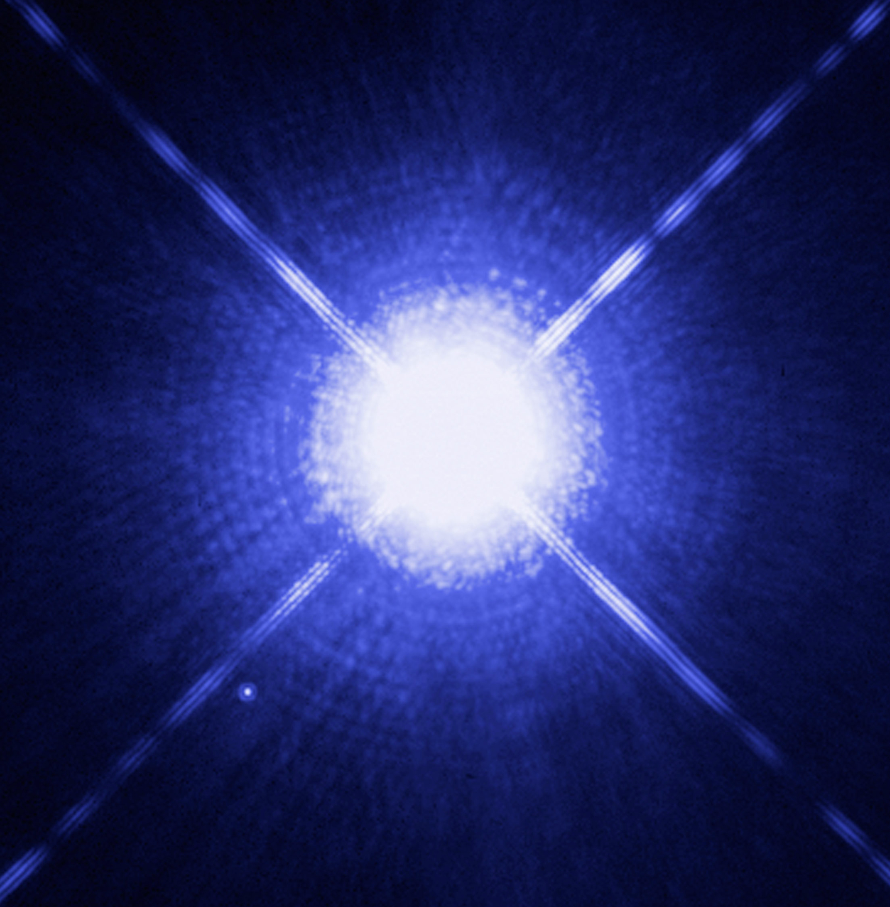
Other MagAO-X Science: Sirius-Like Systems
HST image of Sirius A, the “dog star” & Sirius B, the “pup”

Slide 36
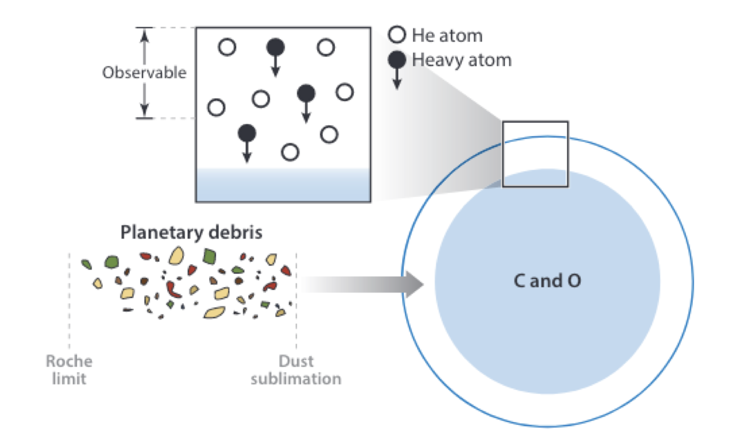
The influence of wide companions on the planetary regime through WD+MS binaries
White dwarfs are probes of planet composition
“Polluted” WDs with wide main sequence companions can probe influence of companion on planetary regime.
“Sirius-like” systems (WD + AFGK) are difficult to detect b/c star outshines WD
ExAO can contribute to both exoplanet and WD communities
Jura & Young 2014

Slide 37
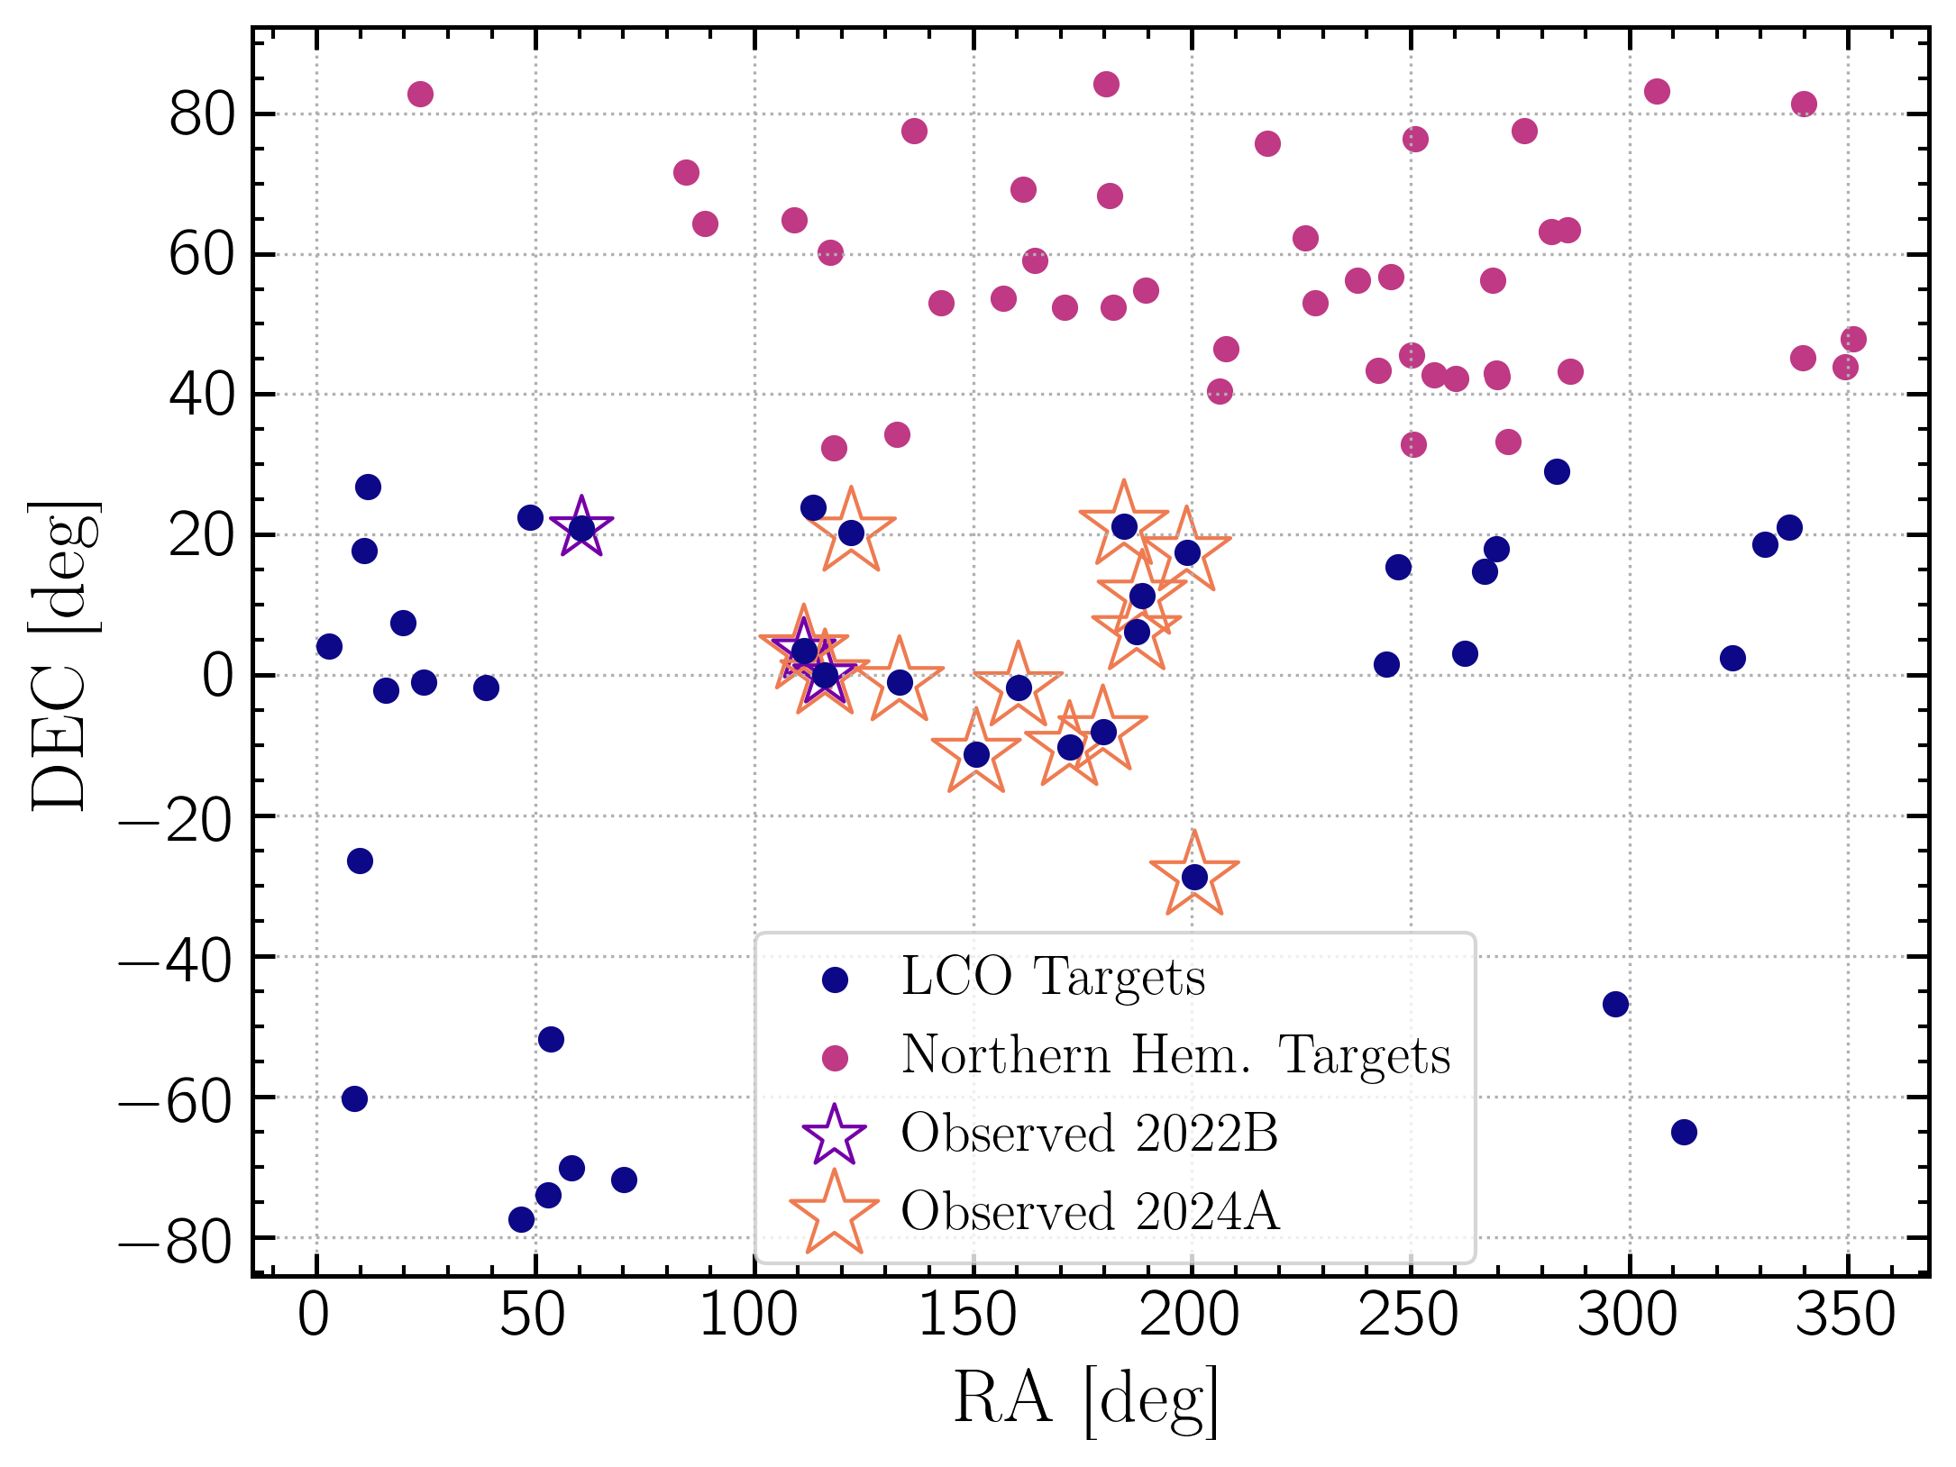
The ExAO Pup Search
Detect new SLS w/ MagAO-X
Observe new and known SLS for pollution
Monitor orbits
High quality target list built from UV Excess and RV data in Ren et al. 2020

Slide 38
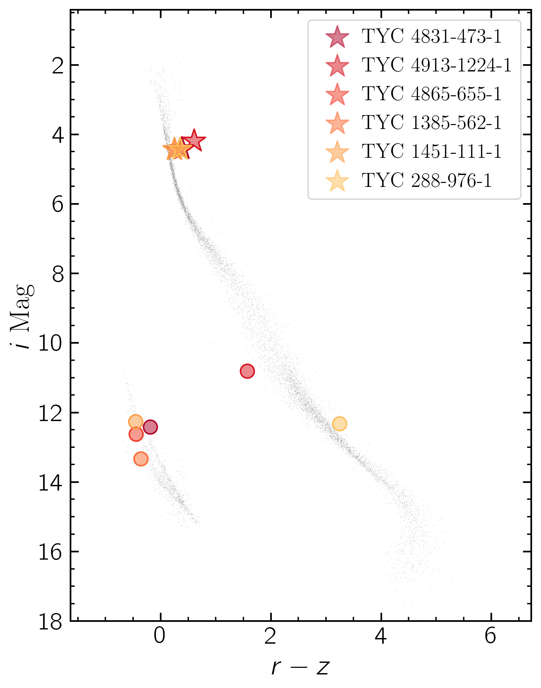
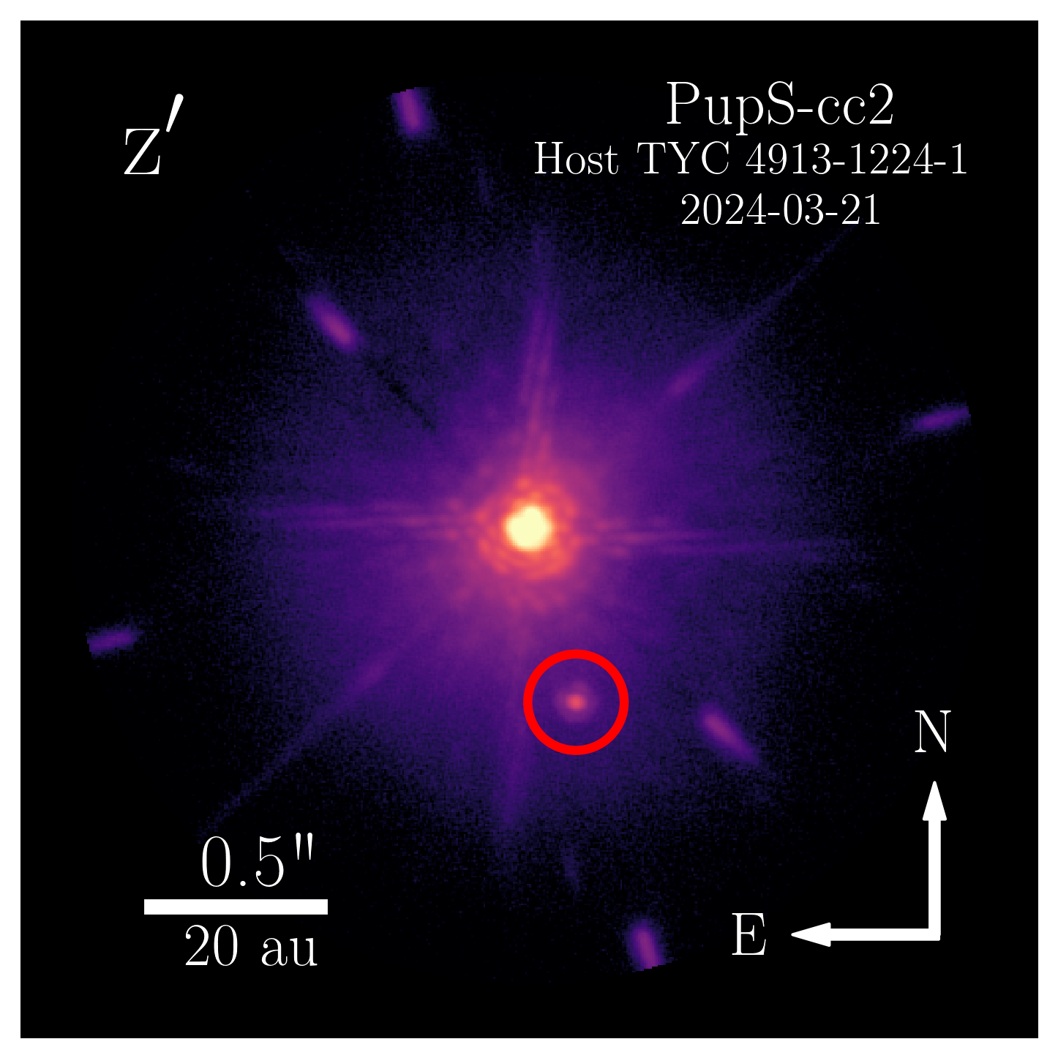
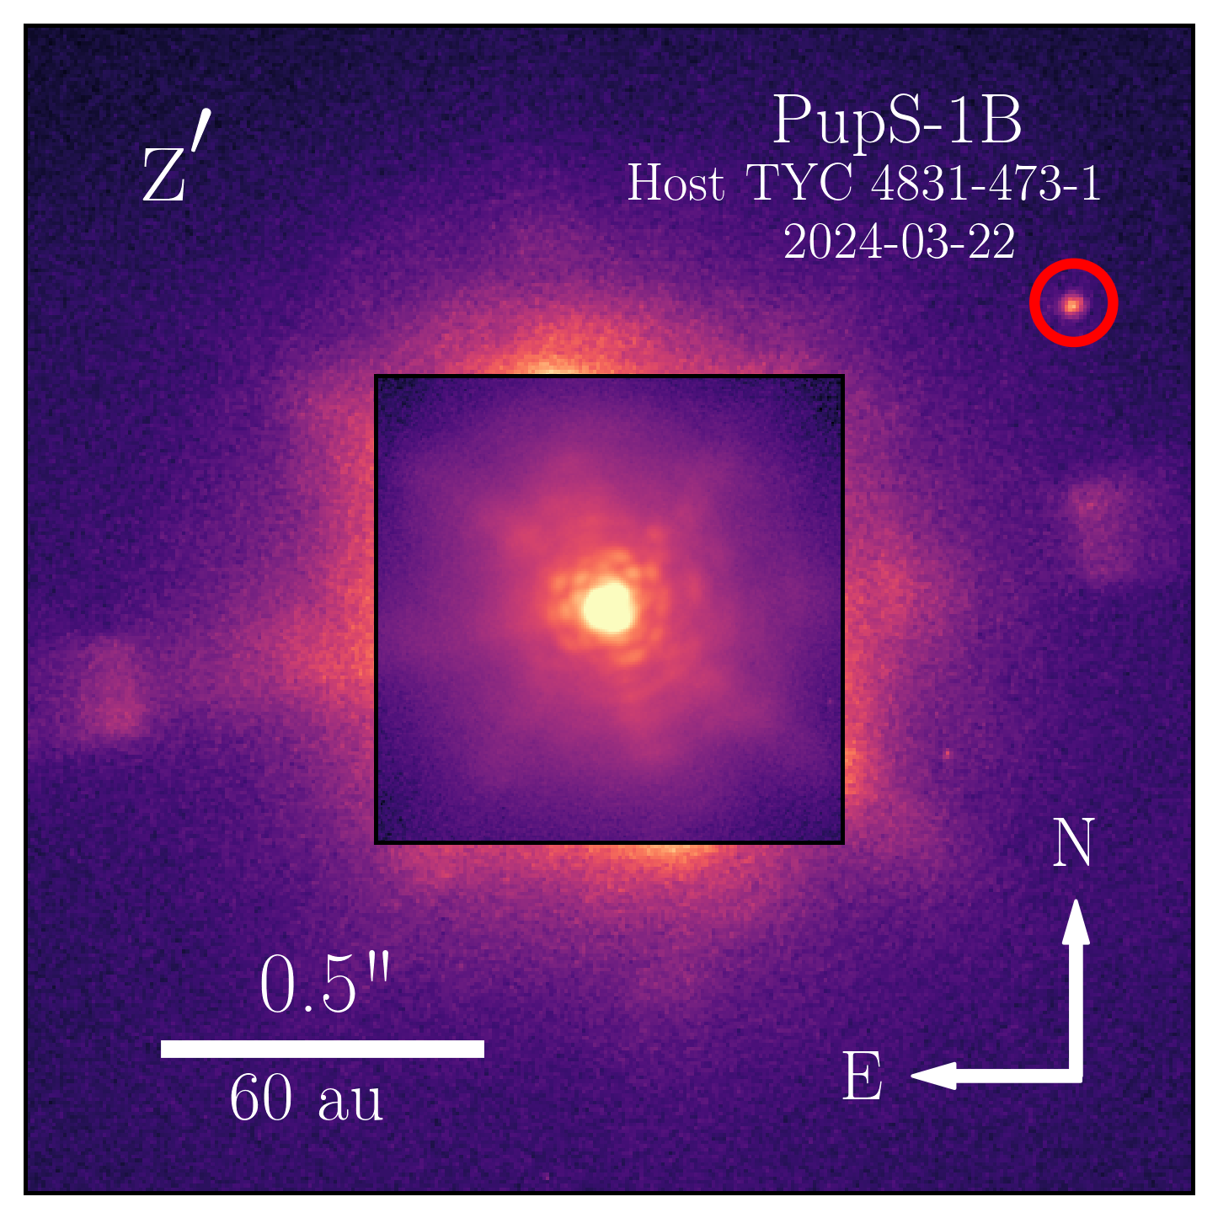
14 observed, 8 new candidate companions
4 WD candidate companions, 1 confirmed
1 subdwarf
1 M dwarf
1 undetermined
Paper to be submitted in a few weeks

Slide 39
Summary
DI with extreme AO is the future of exoplanet science.
MagAO-X is a technology development platform for reflected light imaging.
I am using MagAO-X for the novel application of ExAO to WD+MS binaries with the ExAO Pup Search.
I am preparing the ReflectX model suite to prepare for exoplanet reflected light imaging.

